Slide 1
Color Image Processing
By,
Navya Sushma Tummala,
Wahab Nadir Kadiwar,
Jai Vardhan Singh Shekawat,
Fabian Mendez,
Sikender,
Tyler,
Israel Perez.

Slide 2
Objective
To develop a -----(gui selected to be mentioned ex: flask) based web application to perform color image processing operations on an given input image.
The color image processing operations involve:
Color Image Transformations
Rgb to HIS (Hue Saturation Intensity)
Rgb to CMYK (Cyan, Magenta, Yellow and Black)
Image smoothening
Image Sharpening
Intensity Slicing

Slide 3
Roles and Responsibilities
Section | Implemented by
Color Image Processing | Navya Sushma Tummala

Slide 4
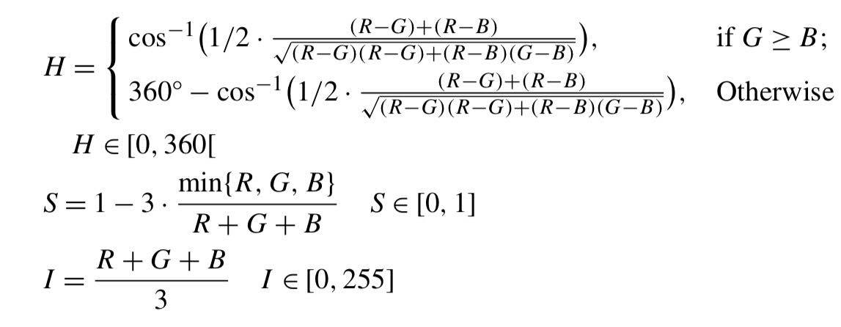
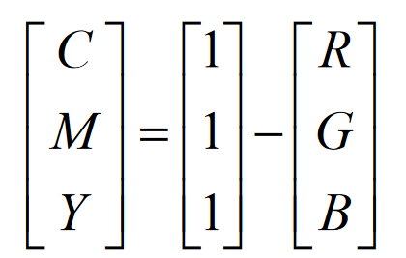
Color Image Transformations
Operations
Rgb to HSI:
Rgb to Cmyk:
Transform to cmyk with some operations
Calculate minimum of cmy

Slide 5
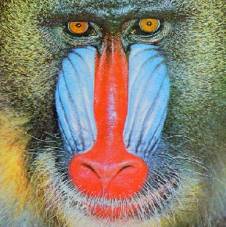
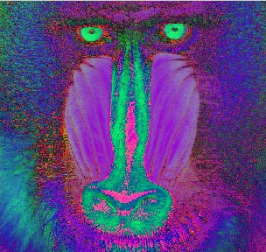


Cont…
Rgb to His:
Rgb to cmyk:

Slide 6
Libraries Used
Section | Libraries planning to Use | Libraries planning not to use
Color Image Processing | Opencv,numpy | No other libraries other than these.

Slide 7


